Slide 1
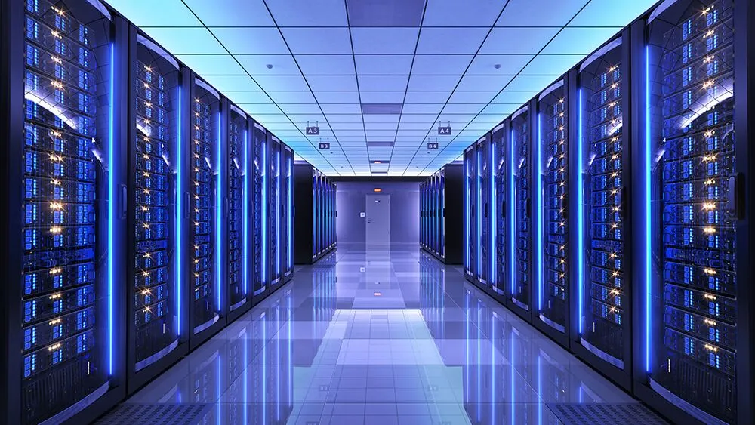


Data Center
Energy Usage
Putting energy use in perspective
BB 49 | HUDZ Presentation | Tuesday, June 30 2026
City of St. Louis Planning & Urban Design Agency

Slide 2


Outline
Ameren’s Service Area and Energy Mix
Renewables at Scale
Data Center vs Industrial/Commercial Uses
Pollution Comparison
City Community Emissions
Mitigating Challenges of Energy Demand

Slide 3
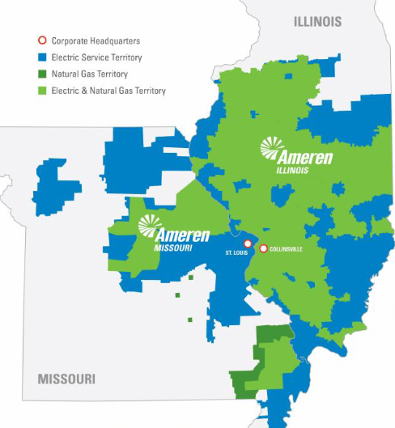
Ameren Service Area
Extreme challenge for utilities to meet growing energy needs, including from data centers
New demand requires new power generation and transmission infrastructure
transmission costs are borne by customer (i.e., developer)
new energy generation costs may impact all ratepayers
Any new costs for generation are shared by ratepayers across Ameren’s entire territory.

Slide 4
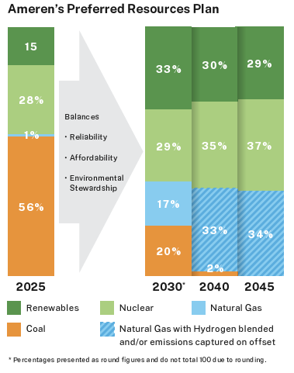
Ameren Energy Mix
Ameren has renewable energy programs but limited supply in current mix
Current mix has about 12% renewable energy in the form of solar and wind
Requirement by the state to have a minimum of 15% renewable energy in the next few years
Completes updates to its Integrated Resource Plan every 3 years with one being filed this fall

Slide 5

Renewables at Scale
Solar and wind power are not constantly deployable like gas power
25% factor for solar; 33% for wind
25MW data center would need 100MW of solar to be 100% powered by solar
or 75MW of wind
1MW of solar requires approx 5-10 acres e.g., IKEA rooftop
If approvals go smoothly, solar can be built in less than 2 years

Slide 6
Data Centers Are Not A Typical Commercial or Industrial Use
A typical data center uses 10 - 50 times more energy per square foot than a commercial office building (energy.gov)
A large hyperscale or AI data center could use 20 - 50 times more energy per square foot than a hospital if it has high server density
Our largest energy users, based on BEPS, are hospitals and grocery stores - these are considered commercial uses
Benchmarking data center performance using ESPM is recommended by the US Department of Energy

Slide 7
How Much Power?
A 30MW data center uses as much power as:
22-25,000 homes, depending on its use and efficiency
A 13.7million sqft office space (approx. double the size of the Pentagon)
73,000 EVs driving 12,000 miles/year
Comparable to a medium chemical/manufacturing facility's energy load (however, chemical plants may also use natural gas and steam rather than strictly electricity)

Slide 8
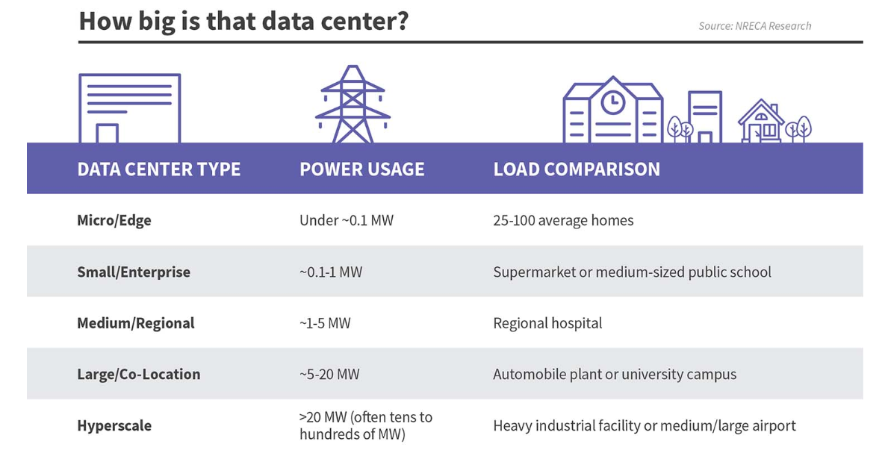
Data Centers Are Not A Typical Commercial or Industrial Use
https://cepci.org/the-rise-of-data-centers/

Slide 9
Pollution Comparison
Data centers do not emit pollution like typical industrial plants with smoke stacks (direct emissions).
Emissions are mostly indirect, coming from the energy generation process
i.e., from the power plant, if not powered by clean energy
Direct emissions or local air pollution comes from generator use (NOx, SO2, VOCs, PM, odors)
Emissions from generators vary depending on when they used/tested and for how long
Example: If tested for 15 minutes at full capacity, a 2MW Tier 4 generator running is similar to having a parking lot full of cars idling for 15 minutes

Slide 10
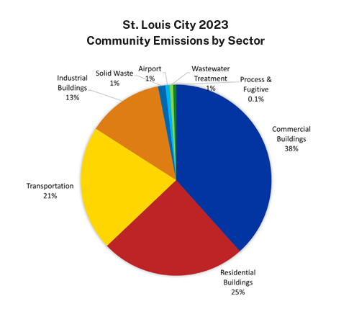
Emissions Comparison
Emissions from industrial buildings account for 13% of the City's total community emissions.
Based on Ameren's current energy mix, a 120MW data center running at full power demand could account for 8-9% of the City's community emissions
Varies based on usage
and grid mix
2023 City of St. Louis GHG Inventory

Slide 11
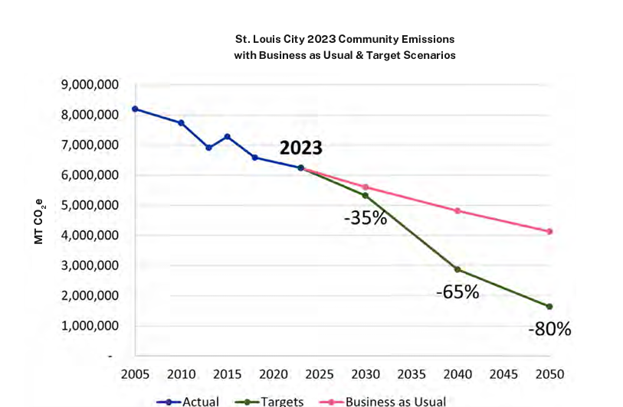
Community Emissions Reduction Goals
1.51% reduction/year rate - Business as usual means we only get to 50% of our goal by 2050
In the face of data centers, there’s an immediate need to deploy emissions reduction strategies at scale

Slide 12
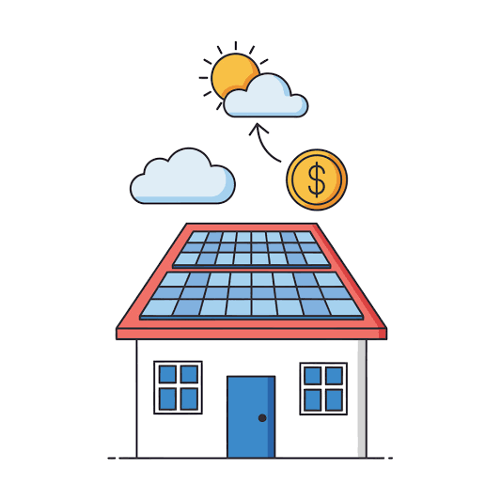
Energy Demand and Costs Will Continue to Rise
Increased in energy demand for many reasons, especially data centers, means we need to activate emissions reduction strategies
Drive energy investment toward households/small businesses*
Consider households as energy infrastructure
Dedicated fund from Data Centers/Large Energy Users (tax revenue, PIAs, CBAs, etc.) to mobilize energy upgrades for residents and small business owners
Reduces energy burden on owners/renters, mitigates local emissions, helps stabilize the local grid, can help protect residents from rising energy costs
*Key strategy outlined in Rewiring America Report, Homegrown Energy: A policy blueprint for energy affordability
Notes:
We don’t control the rates, but we can drive investment to mitigate negative outcomes
Reducing soft costs
Requiring large new energy users to invest in distributed resources
Enabling inclusive utility investment
Modernizing rate design
Redirecting gas infrastructure investment
Scaling virtual power plants

